Slide 1
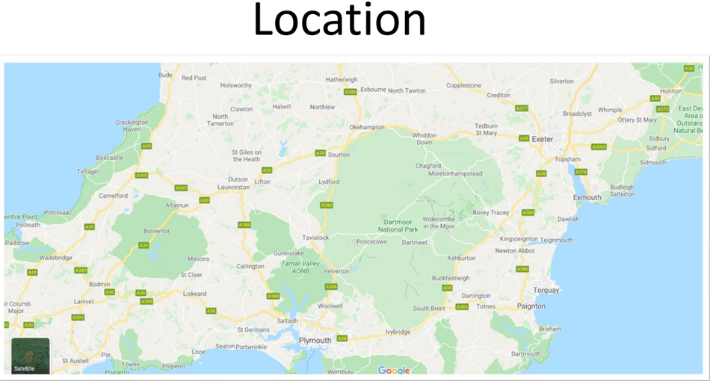
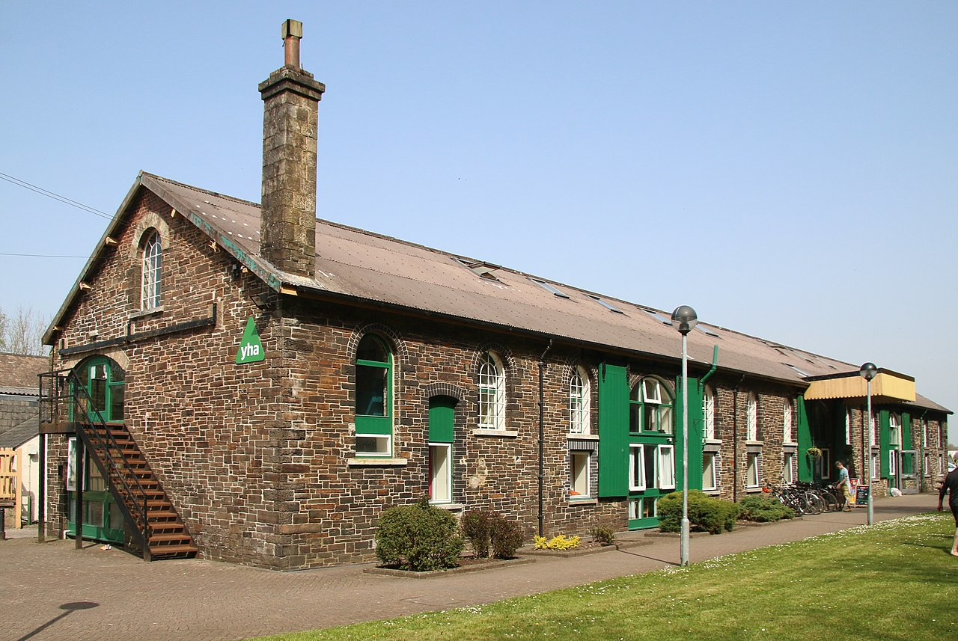
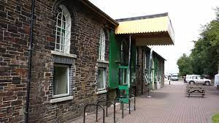
Adventure Okehampton
LS
We’ve been before in 2021 and 2022 and it was successful from both a fun and safety point of view.
It offers good outdoor activity opportunities.
It’s not too far away.
Usually the site is part of the YHA but we have exclusive use of the
building and grounds during our stay which will be closed to the public.
The building is the old goods-shed for the railway.
Dormitory accommodation
2x games/ common rooms
Outdoor area/ playground for free time.
Dining hall and small tuck shop

Slide 2
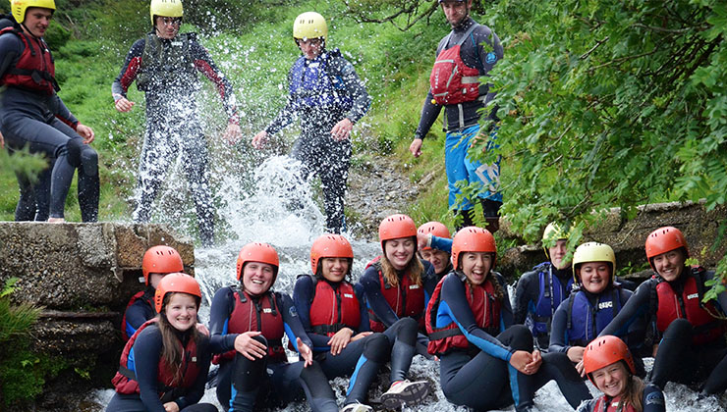
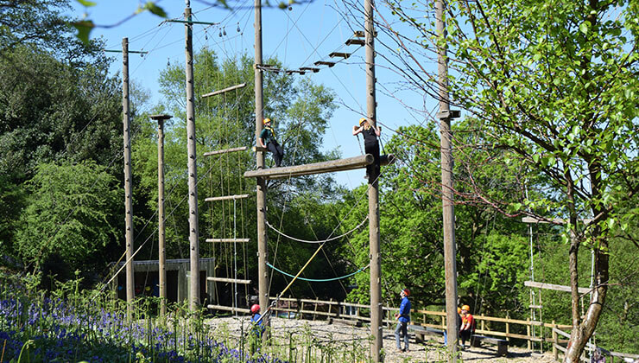
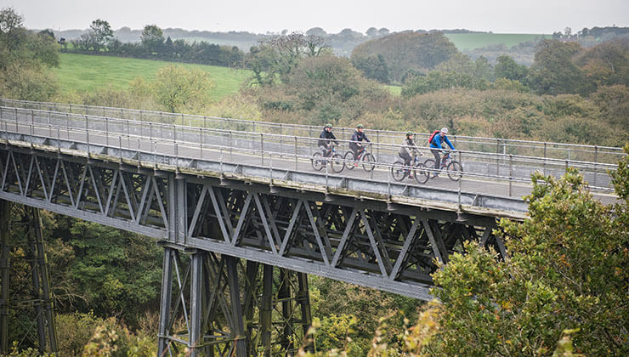
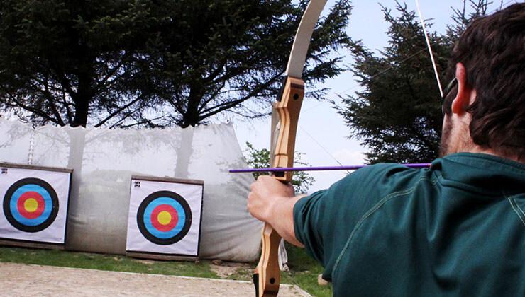
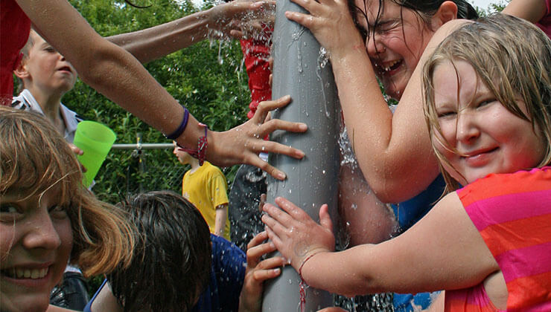
Activities
RL
Our activity schedule is still TBC but it will consist of activities such as:
Gorge Scrambling
High ropes
Cycling
Rock climbing
Weasling
Archery
Night walk
Team challenges
Kayaking
Canoeing
Raft Building
There are 6 activity groups of roughly 12 children. Each group will have Elmlea staff/helpers assigned to their groups in addition to Adventure Okehampton’s qualified instructors.
Evening activities will see activity groups combine to make 2 much larger groups.
All specialist safety/activity equipment is provided by Okehampton.

Slide 3
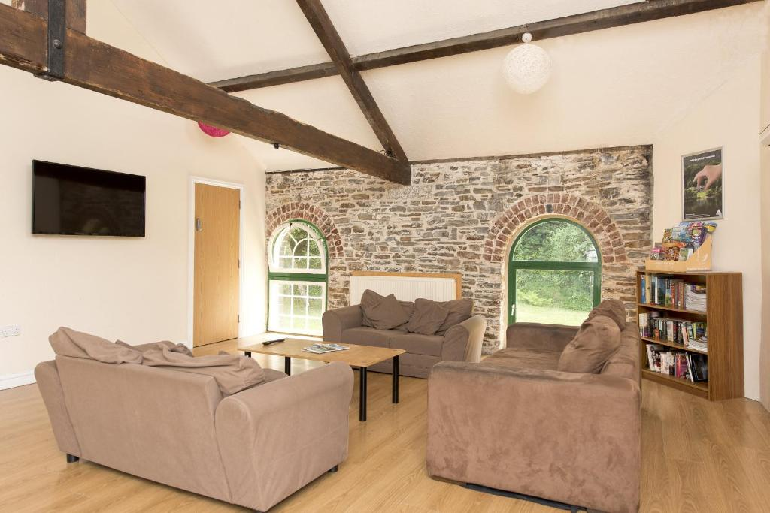
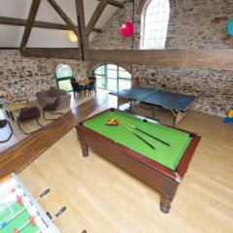
Typical Schedule
GD
Monday
Travel
Welcome, have lunch and unpack on arrival
Activity
Dinner
Free-time and shop
Evening activity
Bed
Tuesday etc…
Breakfast
Activity
Lunch
Activity
Dinner
Free-time and shop
Evening activity
Bed
Friday
Breakfast
Pack!
Activity
Lunch
1pm Travel
Back about 3pm
In-between each activity there are lots of small pockets for free-time and simply hanging out with their friends which they love but the daily schedule is pretty packed.

Slide 4
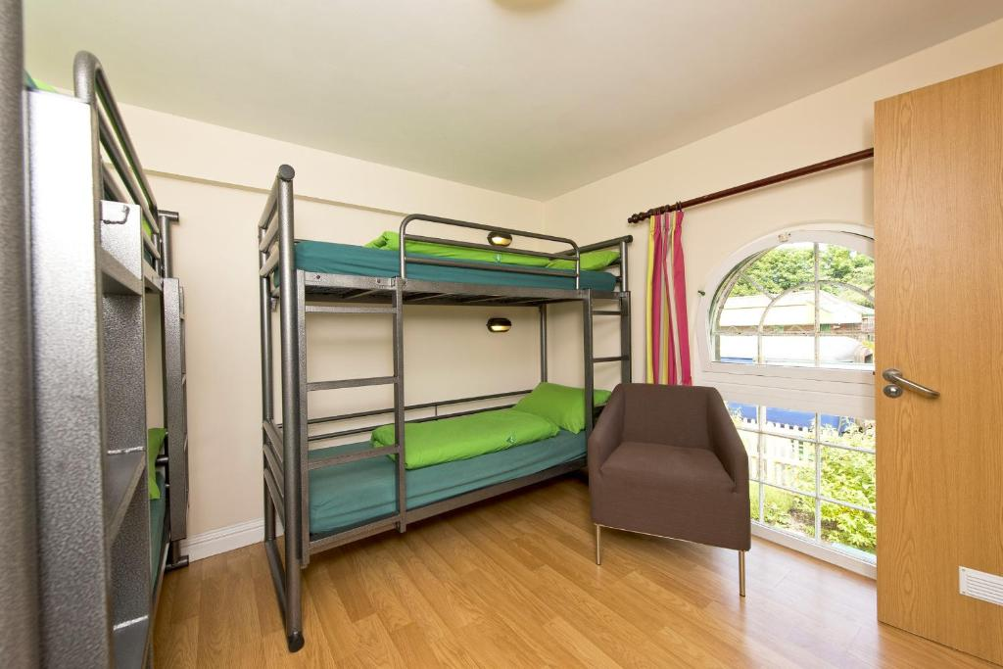
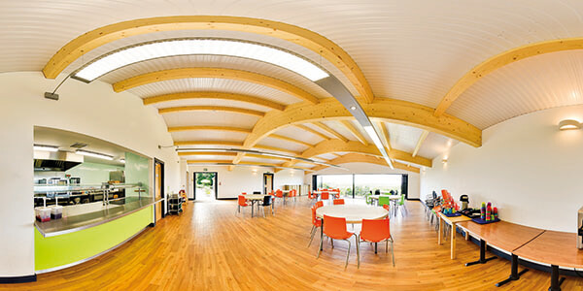
Accommodation & Catering
LS
Accommodation
Dormitory style rooms (range from 4-6 people in each).
Children have an input into room selections.
Some rooms have en-suites, others have toilet and shower facilities on their corridor.
Separate corridors for girls and boys.
Adult rooms on each corridor in case of emergency.
Building locked at night.
Bedding is supplied - children make their beds on arrival (great entertainment!)
Catering
Okehemapton cater really well for all dietary requirements. You will need let us know your child’s needs on the medical forms when they are distributed.
Breakfast – Cooked breakfast every day plus cereal and toast
Lunches – pre-made packed lunches. Ham/cheese rolls, fruit, crisps, cookie
Evening meal – Spaghetti Bolognese, roast dinner, chicken pie, Pizza – all with veggie options and puddings
(all TBC)

Slide 5
Medical
RL
A detailed medical form will be sent to you prior to the trip.
We’re used to dealing with a whole range of medical needs which become relevant on a residential. Please contact your child’s class teacher about any concerns you have or situations we should be aware of so we can put plans in place. We can be very discrete if conditions are sensitive.
Year 6 teachers are all trained in the administration of medicines and have experience of administering meds at various points throughout the day.
We have a separate staff area for the storage of meds – including a fridge.
Please be organised with your medical forms and in handing meds to the office. Everything needs to be done thoroughly by the book.
e.g. all meds must be in original packaging, if you turn up on the morning of Camp with meds, you will need to complete a form before which could delay our departure.

Slide 6
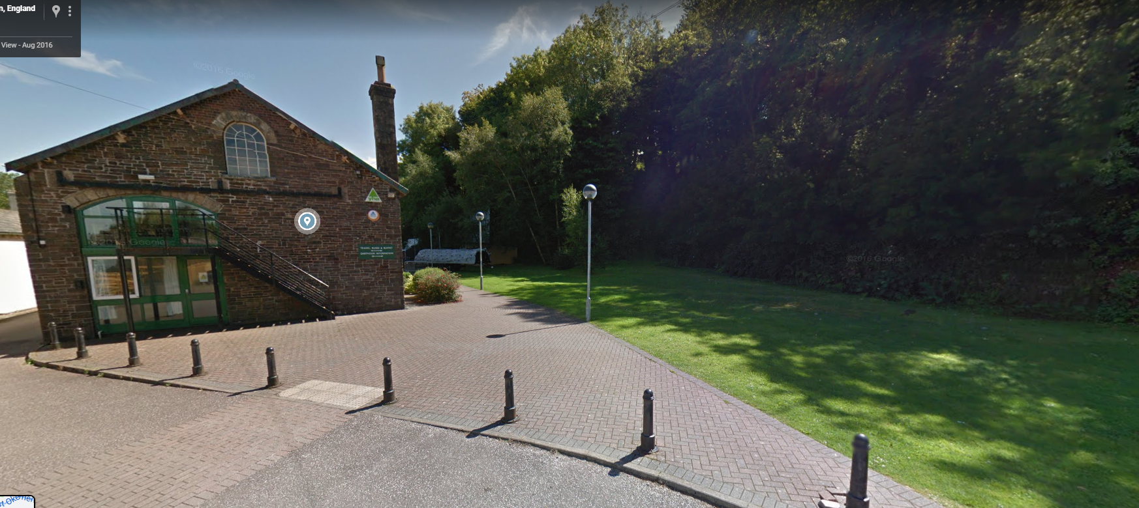
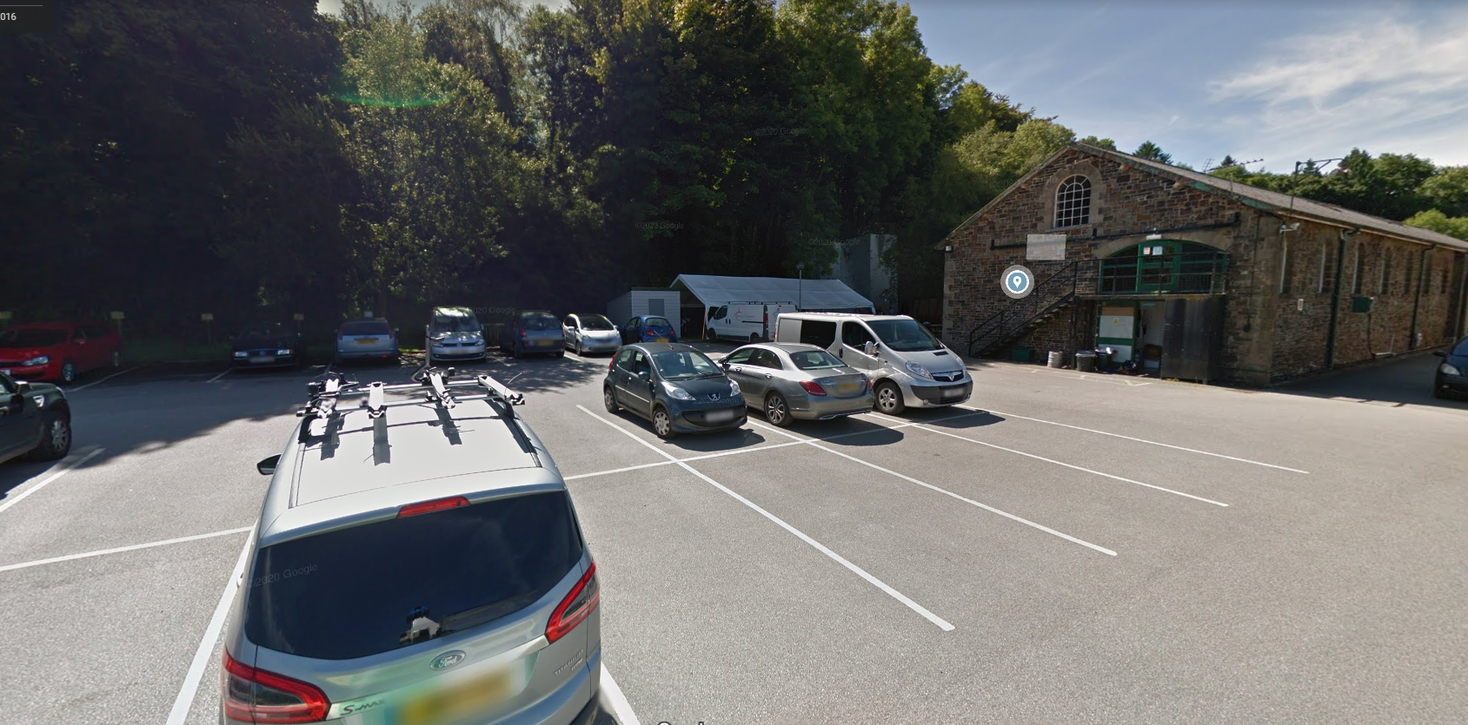
Logistics and Pricing
GD
No phones! No electrical devices or valuables. They are there to escape technology!
All staff will take plenty of photos and communicate via Twitter feed
Staffing – children will be accompanied by school staff but we will also need a couple of parental volunteers. If you’re keen to put yourself forward, please pass your name onto the office.
Kit lists, medical forms and precise details to be shared in due course. (8:30am-ish arrival at school)
£424 total. £363 for Camp, £61 for travel. Please see your letter for the breakdown of payments.
‘We expect all year 6 children to come to Camp’. If you are concerned about finances or your child is in receipt of free school meals then please contact the school office.
Car park becomes a playground

Slide 7
Questions?

