Slide 1
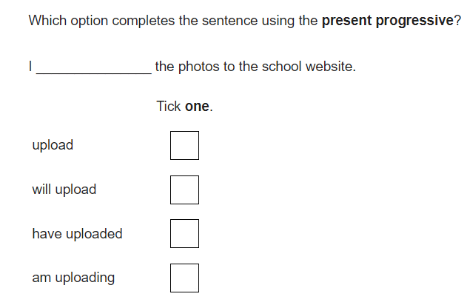
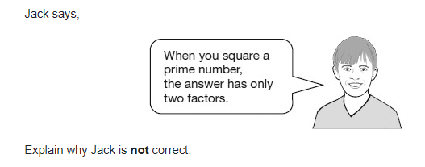
Parent Information Evening:
Year 6 Expectations and Assessment
Welcome!
Please feel free to browse any of the resources before we start.
Part 1
Year 6 Curriculum and Assessment
Part 2
Year 6 Residential (camp)
LS

Slide 2
Why hold this meeting?
AIMS:
To increase understanding of the age-related expectations for Year 6 pupils and explain the Year 6 assessment system
To provide guidance on how to support pupils both in school and at home
To provide information about the residential 16th June
To answer any queries that you may have about this year and browse some helpful resources.
We’ll finish punctually by 7pm.
Please feel free to chip in with questions at any point. No question is silly – especially if we slip into using education jargon that you don’t understand.
These slides will be available via a link in the newsletter to the school website after the meeting.
LS

Slide 3
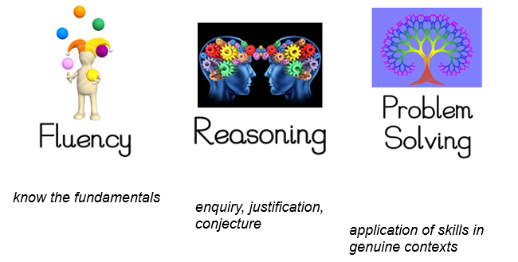
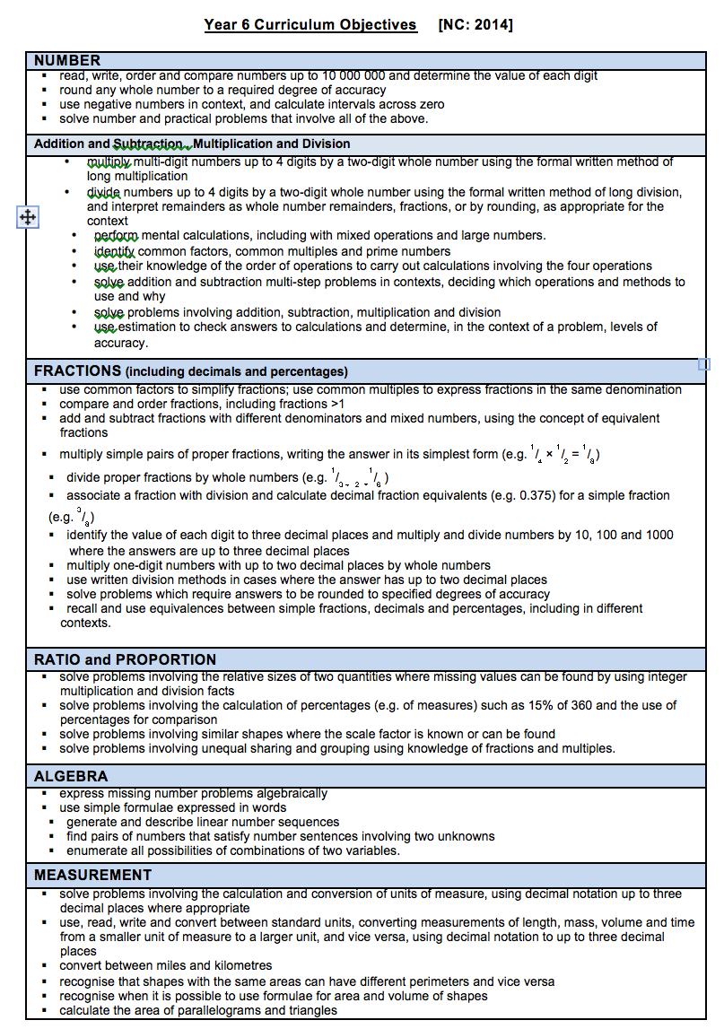
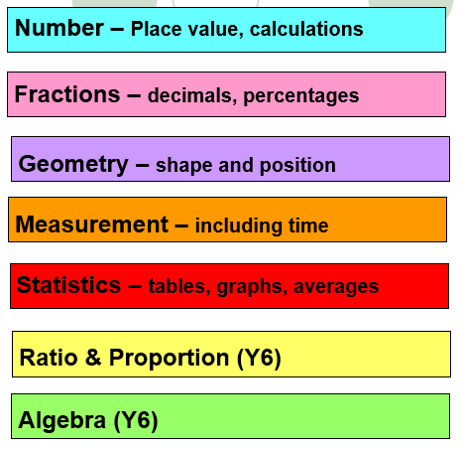
Maths Curriculum
Curriculum in Y6
National Curriculum: Maths
*The aims of the NC are to ensure pupils are fluent
In the fundamentals of Maths, are able to reason
and to problem solve by following lines of enquiry.
*The main strands of Maths:
-Number
(including FDP, Algebra and Ratio/Proportion)
-Measurement
-Geometry
-Statistics
*These objectives must be met in order for a child to be at the ‘Expected Standard’
LS

Slide 4
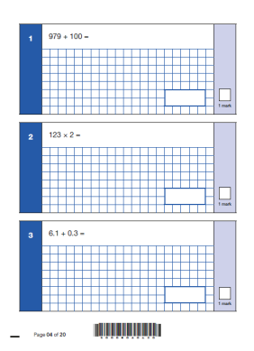
Age-Related Expectations Maths
National Curriculum: Maths
*Another expectation of Year 6 is that pupils
study arithmetic which demands secure written
and mental methods of calculation.
*At Elmlea, we practise short, weekly bursts of
arithmetic, to help pupils to develop their speed and
accuracy but to also familiarise them with the
format of the test.
*See Collins KS2 Arithmetic SATS Question Book
LS

Slide 5
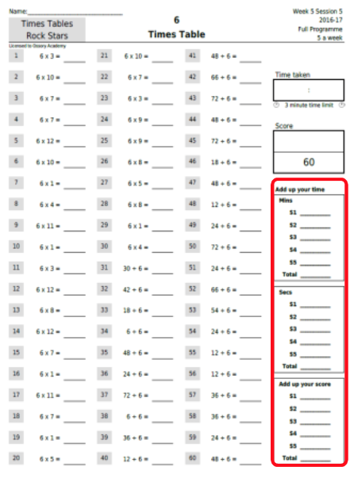
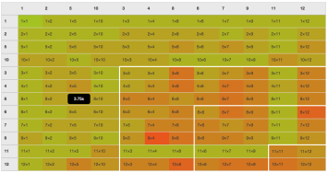
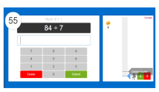
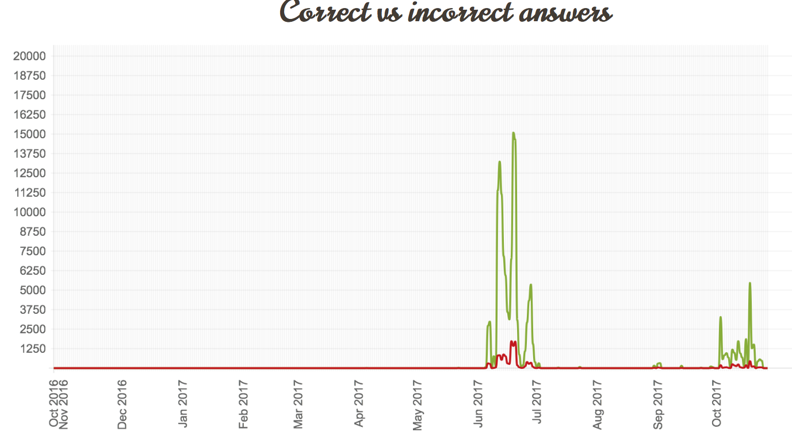
Resource for Rapid Recall:
*We continue to use ‘Times Table Rockstars’ to support rapid recall of multiplication and division facts. Please ensure pupils are using this website at home.
*See Parent Information Guide on TTRs website
Multi-player practise
Graphs to show performance and progress
Solo practise
LS

Slide 6
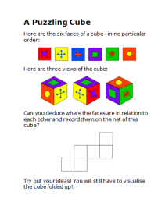
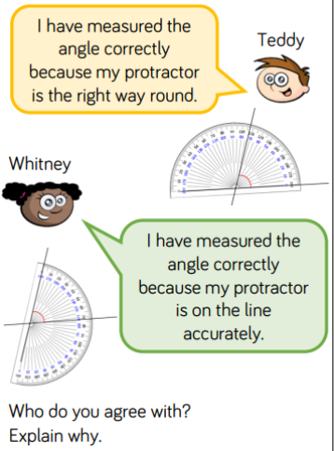
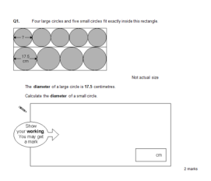
Developing Reasoning and Problem Solving:
*We ensure that our lessons offer opportunities to develop Mathematical fluency, before achieving mastery by applying their knowledge to reasoning or problem solving questions:
LS

Slide 7
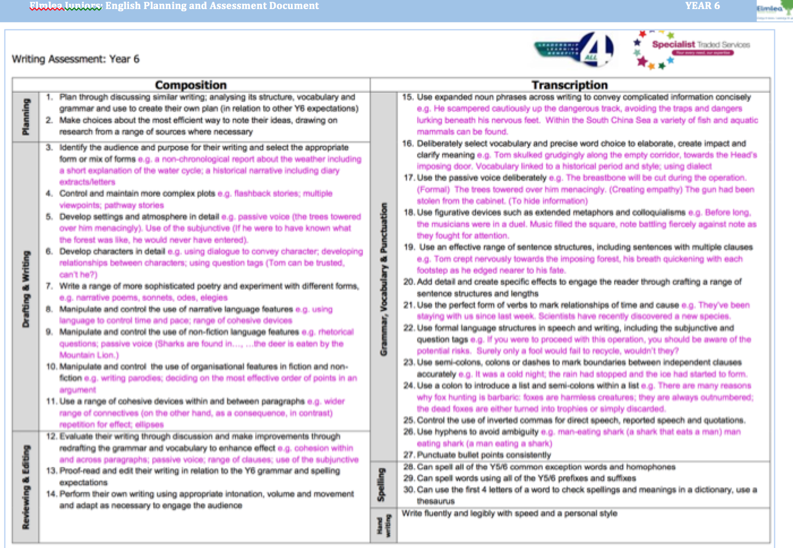
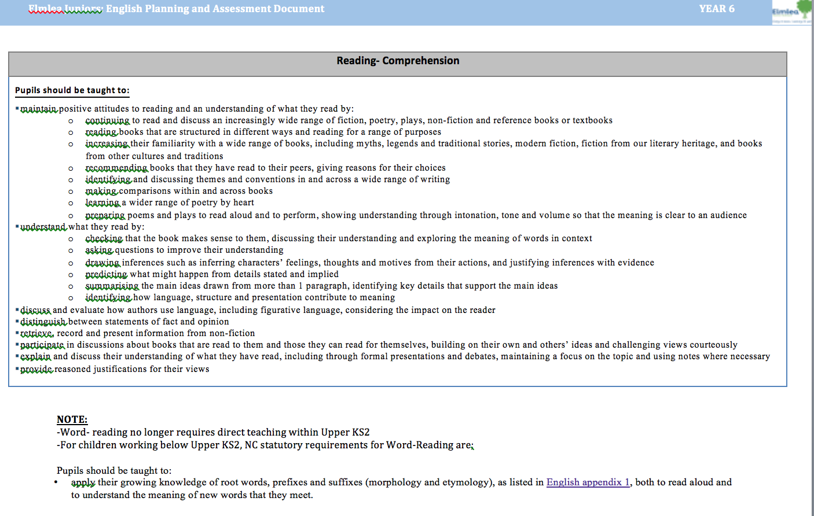
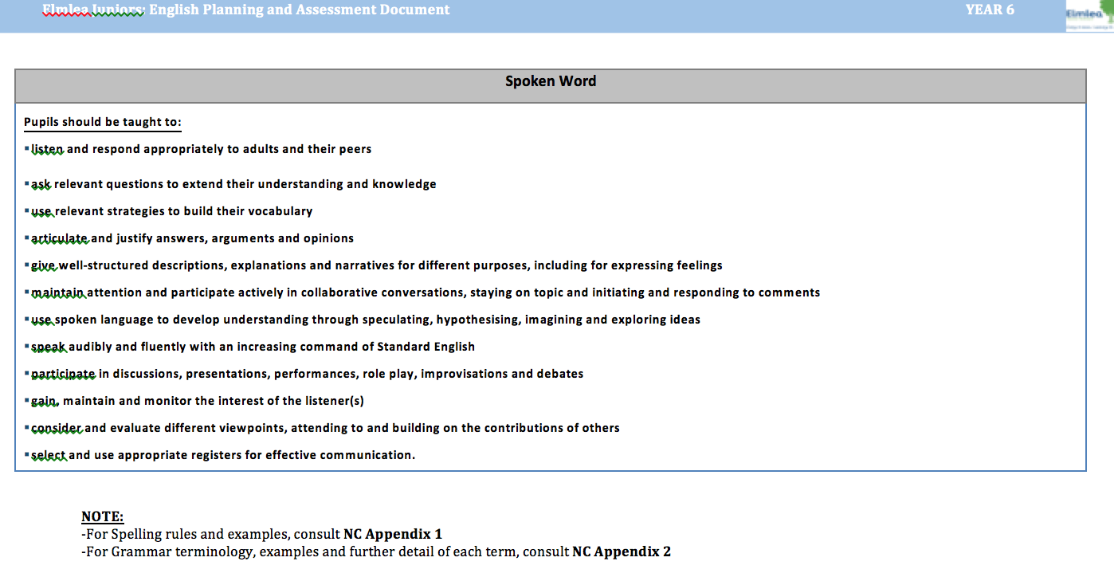
Age-Related Expectations English
National Curriculum: English
English:
-Reading
-Writing Composition
-Writing - Vocabulary, Grammar and Punctuation
-Spelling
-Handwriting
RL

Slide 8
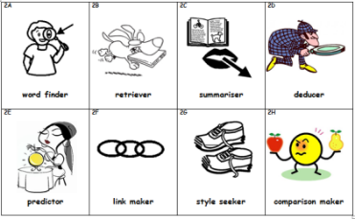
READING
*Children are expected to read a range of texts: fiction, non-fiction and poetry.
*Understand what they read by demonstrating literal retrieval of information, inferring information about characters, settings and plots and explaining the author’s use of language.
*Understand and explain the meaning of words
RL

Slide 9
Reading:
*Read 5 times a week. If your child is a confident reader, who can understand a range of texts, you should still aim to read with them at least once a week. If your child is less able to understand the meaning of texts they read, please try to have someone hear them read at least 3-5 times per week.
*You can use question stems for word finder, retriever and deducer to help clarify if your child is understanding the text they are reading.
*It is great for children to hear someone read to them as well. It builds their understanding and also their speaking and listening skills.
*Challenge children to read books by authors they haven’t tried before.
RL

Slide 10
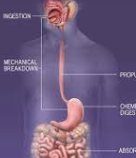
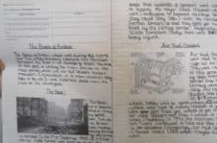
Writing
Writing:
Over the course of the year, the children will write a range of genres. They will either be based around books and texts often linked to our topic or excellent examples of texts. E.g.
Persuasion
Explanation
Non-chronological report
Narrative – different types of stories,
- different sections
- poetry
Teacher Assessed
GD

Slide 11
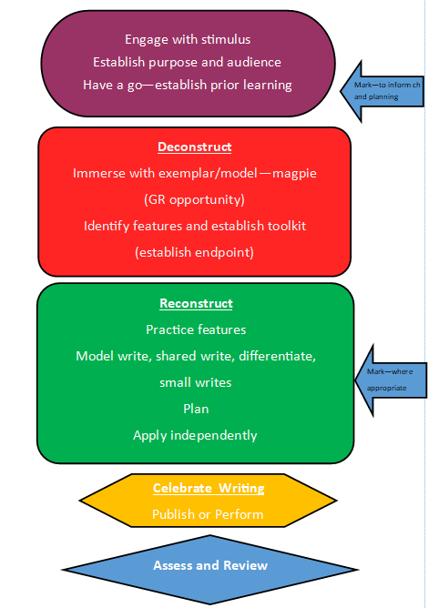
Writing Process:
Engage
Deconstruct
Reconstruct
Plan
Draft
Edit
Publish or perform
Assess & Review
GD

Slide 12
Writing:
At expected standard:
Setting, character and atmosphere description
Accurate verb tenses
A range of punctuation
Cohesion throughout writing (linking)
Vocabulary and grammatical structures
used correctly
At greater depth:
Keeping the appropriate tone/formality throughout unless consciously trying to speak to the reader
Drawing on their own reading experiences to create literary effects
Not the complete list of standards
GD

Slide 13
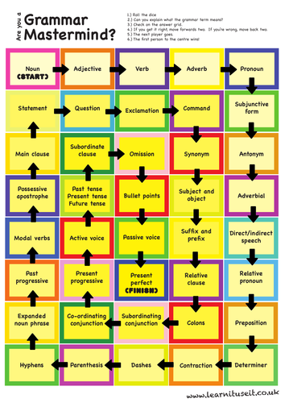
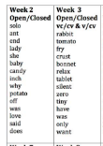
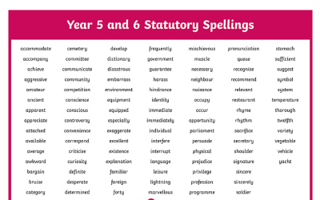
SPaG (Spelling, Punctuation and Grammar)
SPaG:
Spelling, punctuation
and grammar
Handwriting
National Curriculum
Spell correctly most words from the year 5 / year 6 spelling list, and use a dictionary to check the spelling of uncommon or more ambitious vocabulary
Maintain legibility in joined handwriting when writing at speed
RL

Slide 14
Age-Related Expectations Science
National Curriculum: Science
*Science IS a core subject.
*Science is assessed by teachers (not currently a SAT paper… more on them later)
*Elmlea believe in increasing the profile of science as a core subject, alongside English and Maths.
*The aims of the NC are to ensure pupils develop their knowledge of scientific ideas but also their scientific skills – key part of EVERY unit.
Our Rationale:
At Elmlea, we aspire to spark curiosity and build on their understanding of, and respect for, the world around them. We believe in ensuring that pupils understand how science relates to the wider world and to appreciate how it helps to promote logical and systematic approaches to learning. We aim for pupils to enjoy investigating and exploring science in order to inspire them to pursue science beyond primary school.
LS

Slide 15
SATs Standard Assessment Tests
Reception - baseline assessment
Year 1 – phonics screening check
Year 2 – ‘Optional’ key stage 1 tests
Year 4 - Multiplication tables check
Year 6 - Key stage 2 tests

Slide 16
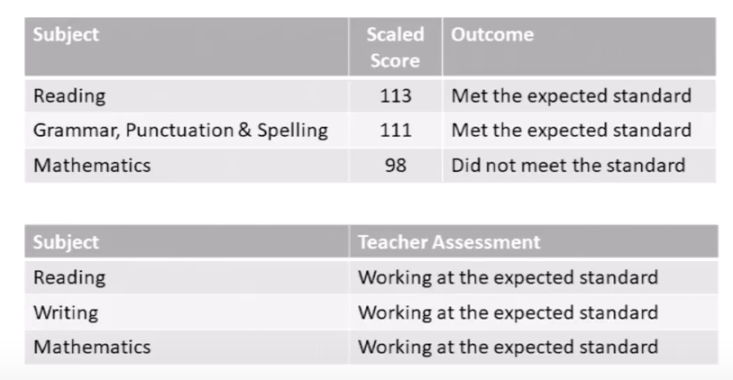
Assessment- Key Terms…. Jargon!
Teacher Assessment:
WTS- working towards the required Year 6 standard.
EXS- has met the required Year 6 standard.
GDS- is working above the Year 6 standard
Statutory Assessment:
RAW Score: the actual number of marks received in the paper
Scaled scores: a converted, standardised raw score used to compare against national averages.
They are used to report consistently across exam years.
A scaled score of 100 will always represent the expected standard at KS2.
GD can be approximated from scores of 110+
LS

Slide 17
Statutory Assessment- SATs
The Key Stage 2 tests are designed to test children’s knowledge and understanding of specific elements of the Key Stage 2 programmes of study. They provide a snapshot of a child’s attainment at the end of the key stage.
Elmlea SATs:
The children are always really well-prepared for the week both academically and mentally through PSHE lessons.
It’s very relaxed, pupils often enjoy the week as it’s an opportunity for them to showcase just how much they have learnt during their time here.
….Plus, they get lots of extra break-time between tests!
SATs Data
The results are stored electronically and are sent to secondary schools. They are used to help inform settings, assign support and as a benchmark to measure progress from.
SATs Information Video:
https://www.youtube.com/watch?v=2H2D1Ul4pjE
LS

Slide 18
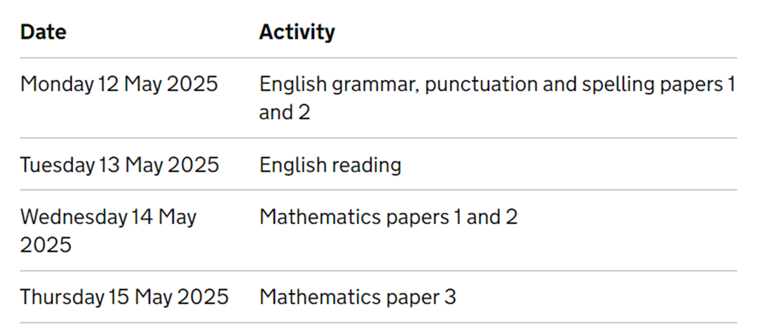
Assessment- SATs Arrangements
Timetable for 2025:
Please avoid any absences.
LS

Slide 19
Assessment- Access Arrangements
Support During Exams:
We ensure that pupils receive the same level of support as they do during their normal, daily lessons.
Small groups continue, reading support is available (to any pupil who needs clarification during the exams), transcribers, extra time or alterations (such as enlargement of text or translations) to papers for those with specific circumstances.
We want to ensure that all pupils are relaxed, motivated and continue to perform just as they would do in any of our day-to-day lessons… DON’T WORRY, WE HAVE IT COVERED.
RL

Slide 20
SATs: English Summary
*There is no longer a writing exam paper.
Instead, pupils’ writing is assessed via teacher judgements and through internal and external moderation.
There are 3 papers:
*Day 1 Grammar, Punctuation and Vocabulary Test: 45 minutes (50 marks)
Spelling Test: 15 minutes (20 marks)
*Day 2 Reading Comprehension Test 60 minutes (50 marks)
GD

Slide 21
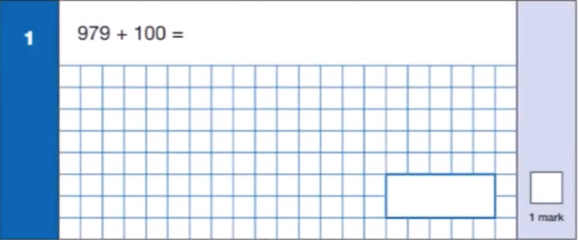
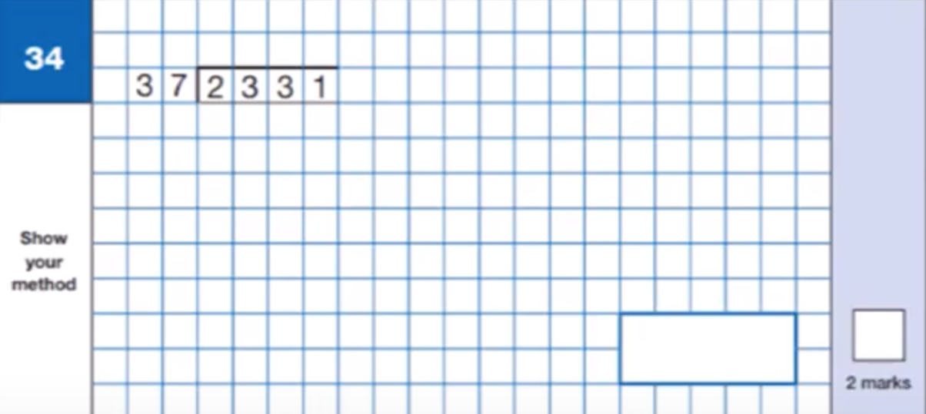
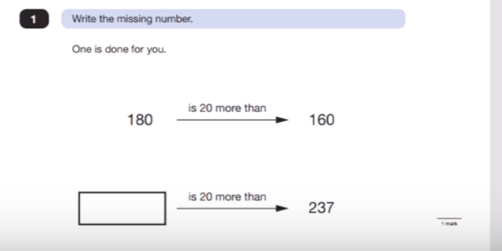
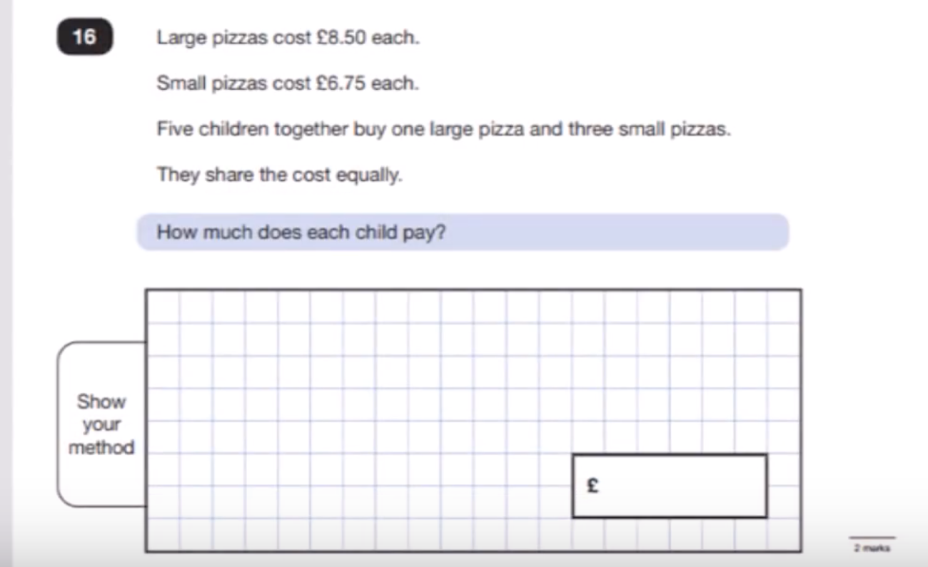
SATs: Maths Summary
*There are 3 papers: (Day 3 & 4)
Paper 1 Arithmetic 30 minutes (40 Marks)
Paper 2 Reasoning 40 minutes (35 Marks)
Paper 3 Reasoning 40 minutes (35 Marks)
*Marks available for methodology
*Reasoning papers are set within contexts
*Arithmetic paper is designed for quick and efficient
recall and application of written methods.
LS

Slide 22
Parental Support
How can I help my child?
• Regular attendance at school
• Support homework
• Revision – a little at a time / often
(Collins books are useful)
• Times tables, number work,
written methods
• Talk about school and concerns
• Manage stress or anxiety levels
*Encouragement and positivity!
Sample SATs Tests:
If you or a tutor are planning to practise past-SATs papers,
PLEASE do not use any of the papers released since 2018; including any sample papers.
We use these within our own assessment systems to identify gaps.
But don’t worry – we’ve got this!
LS

Slide 23
Parental Support
If you have any questions or concerns at any time, about the expectations of Year 6, please contact your child’s class teacher. Parent’s evening meetings are also coming up in the next few weeks.
Any questions?

